Slide 1
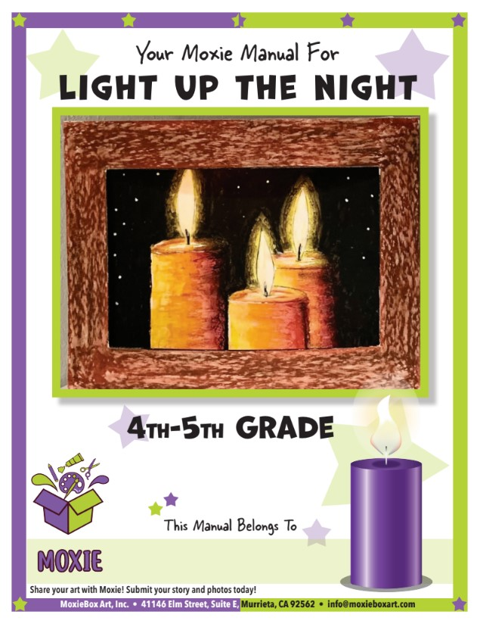
Classroom Supplement

Slide 2
Learn how to draw and ellipse
In this project, you’ll need to know how to draw an ELLIPSE. An ellipse is a shape that looks like a flattened circle.
Repeat in each section making your circle a little flatter each time. In the last section, you’ll have an ellipse!

Slide 3
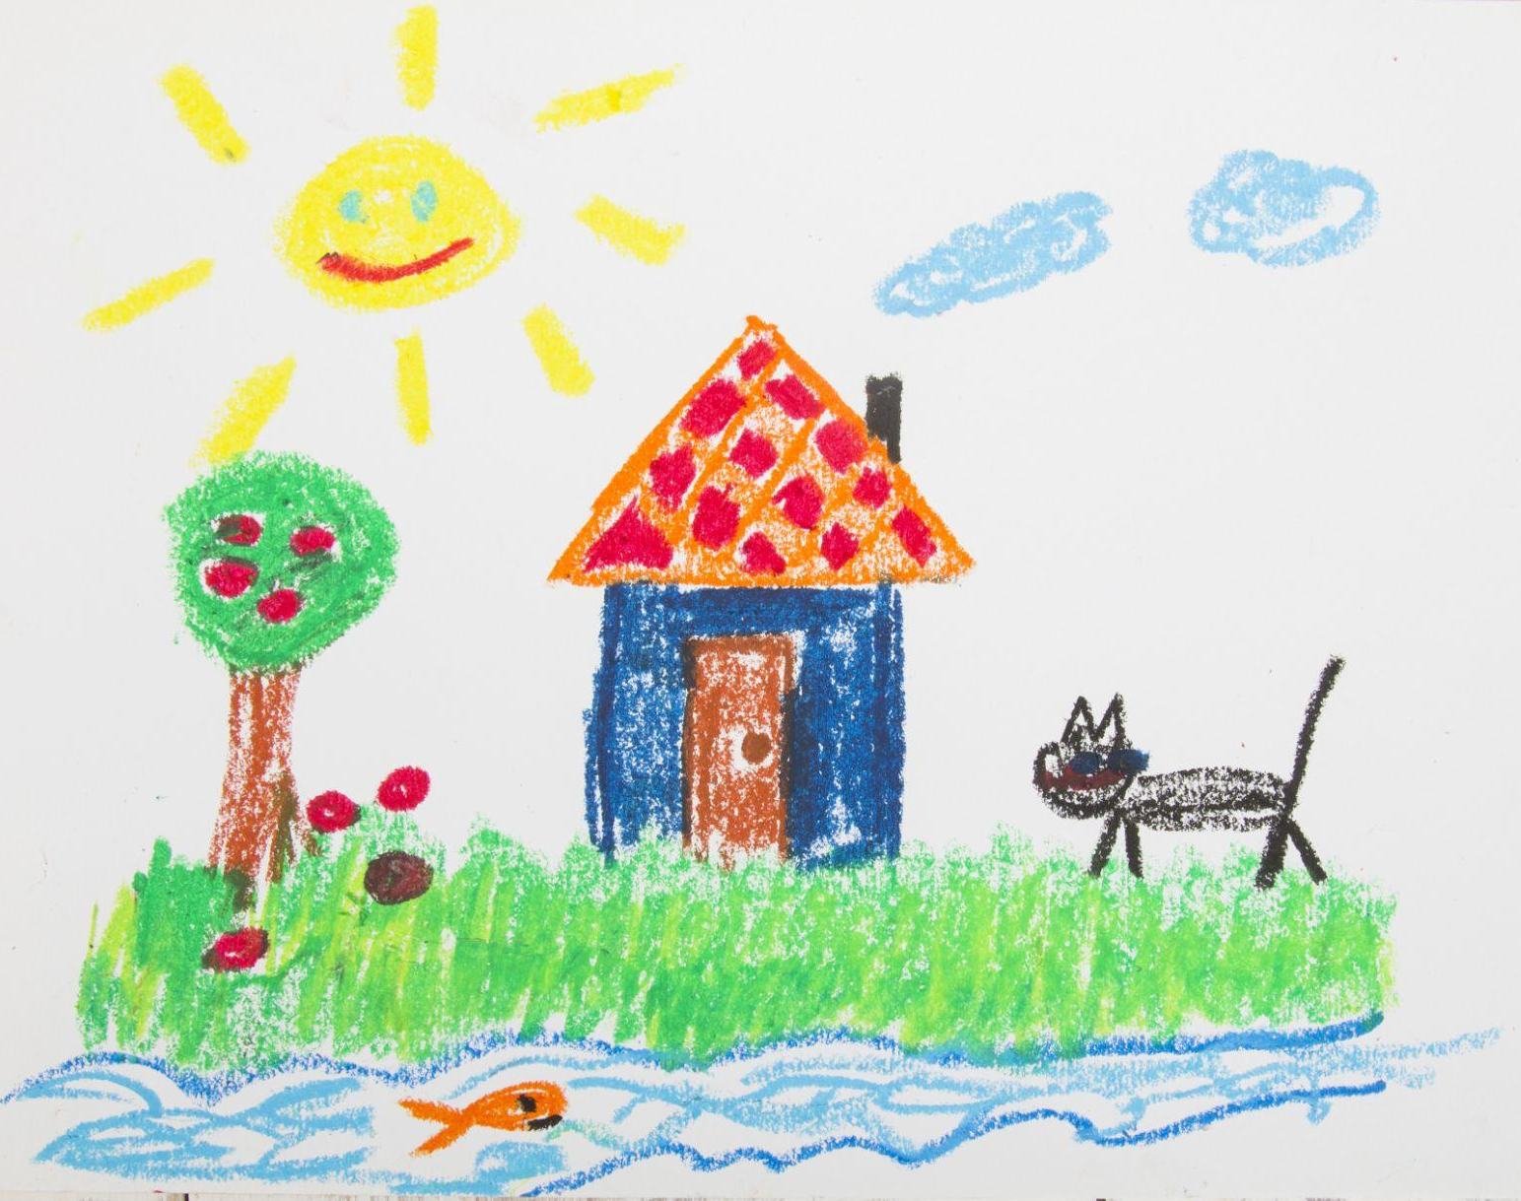
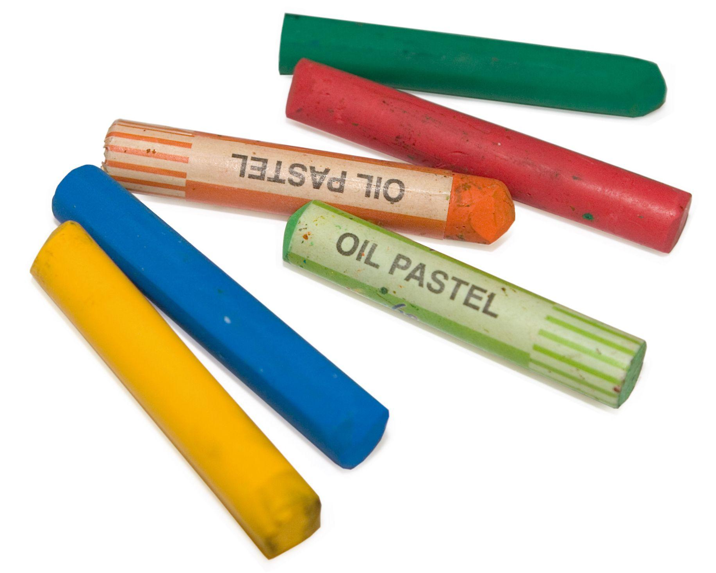
Let’s learn about oil pastels!
Oil pastels were invented almost 100 years ago by a company in Japan called Sakura. Sakura named these oil pastels “Cray-Pas.” Nearly 30 years later, Pablo Picasso asked the art material company, Sennelier, to create some oils pastels for professional artists. Now you can find all different levels of oil pastels in art stores and classrooms everywhere.
You can learn more about oil pastels by clicking this link!

Slide 4
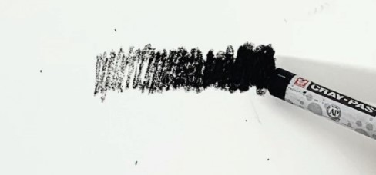
Practice working with pastels
Start by drawing a line with your black pastel. Begin coloring as light as you can and as you continue, slowly start pressing harder so it goes from light to dark.

Slide 5
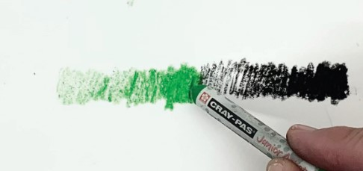
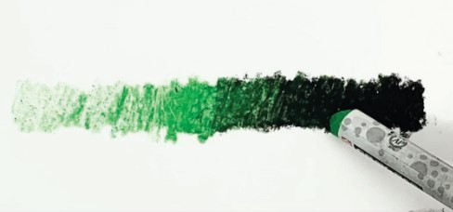
Next, take the color you selected and do the same thing to the left of the black line. Continue coloring green into the black pressing nice and hard.

Slide 6
Then, color white over part of the green to make the light green even lighter. See how many shades of green you can make by adding some white or black.

Slide 7
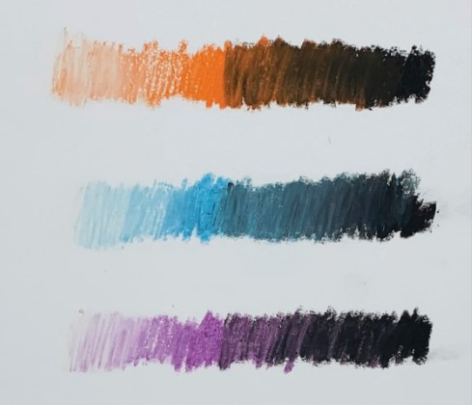
Keep practicing with more pastel colors. See how many different shades you can make!

Slide 8
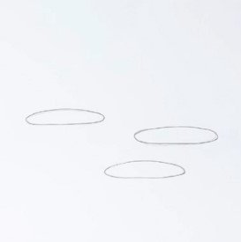
Create your design
Begin by lightly drawing 3 ellipses in the lower half of your paper as shown here.
Draw vertical lines to the bottom of the page from the edges of each ellipse.

Slide 9
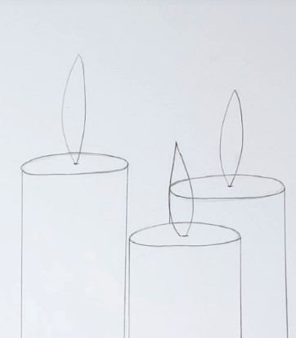
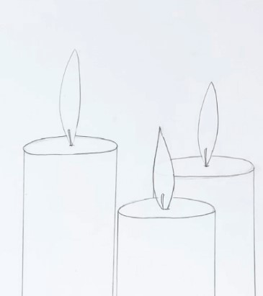
Erase all lines inside of the flame shapes and add a wick to each flame.
Draw a flame starting at the
center of each ellipse.

Slide 10
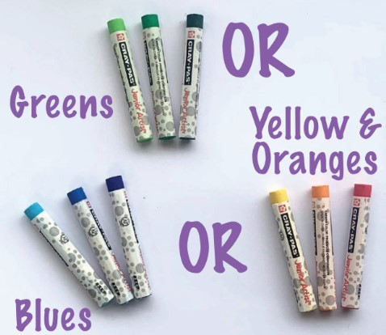
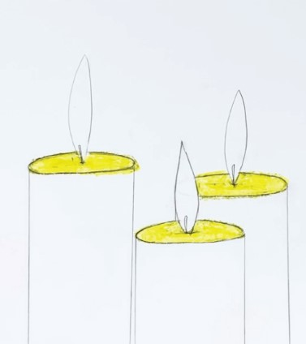
Select the colors you want for your candle. You will need 3 from the same family of colors. One light, one medium, and one dark. See photo for ideas. The color choice is up to YOU!
Color the tops of the candles with your lightest color. Press hard and fill the entire top sections.

Slide 11
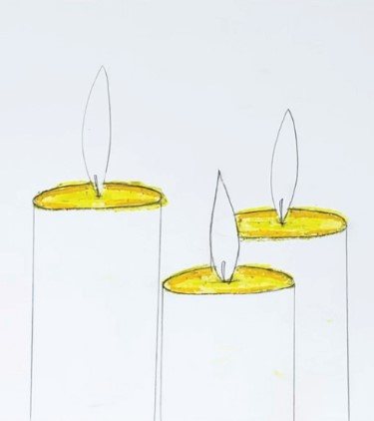
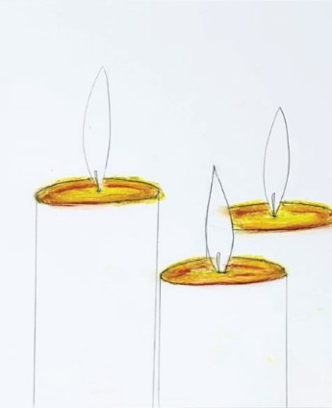
Underline small sections of your medium color with your
darkest color and blend.
Add your medium color around the edges of the ellipses.

Slide 12
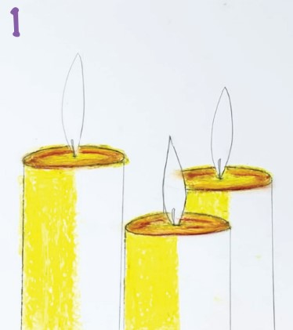
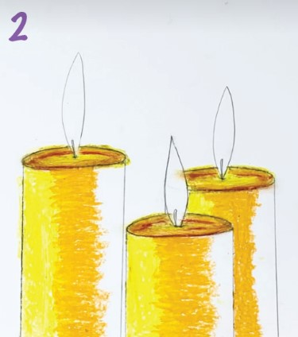
Filling in the candle
Fill in the centers with your medium color overlapping some of the light one.
Take your lightest color and fill in one half of your candle.

Slide 13
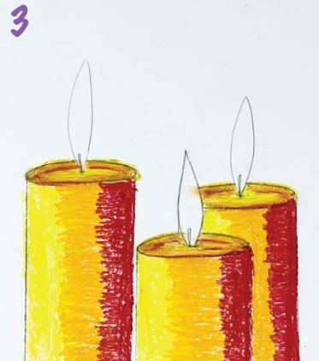
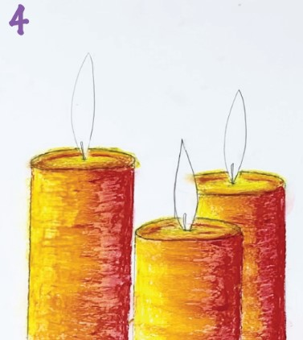
Color the last section with your darkest color.
Blend them all together with your fingers.

Slide 14
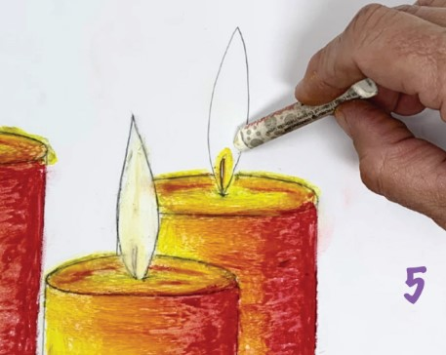
Add a little of your light and medium colors around the wicks and then fill in the entire flame with white, blending them together.

Slide 15
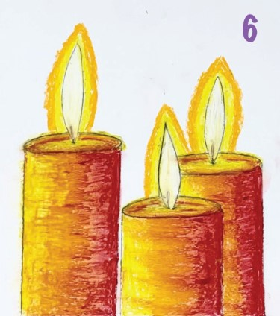
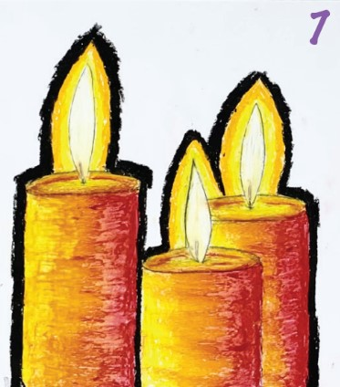
Surround the flame with yellow, orange, and dark red as shown here.
Color a thick, dark line around your
drawing with the black pastel.

Slide 16
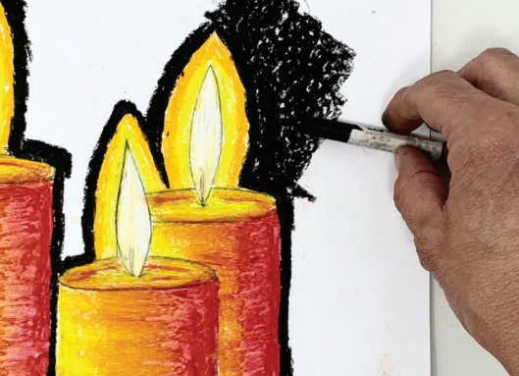
It will be much easier if you remove the wrapper from your black pastel and use the side to fill in the rest of your paper. Make sure you color all the way to each edge.

Slide 17
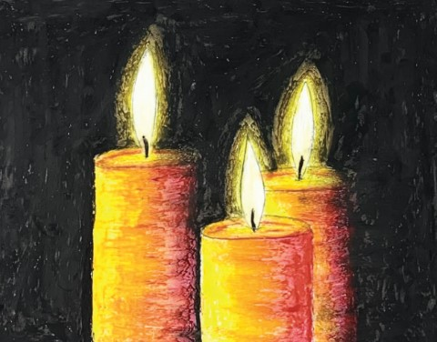
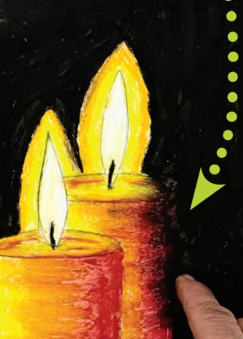
Enhancements
Use one hand to hold it still and the other to blend the black. Try to keep your fingers off the candle and flame to keep them clean.
Cover the colors around
your flame with black.

Slide 18
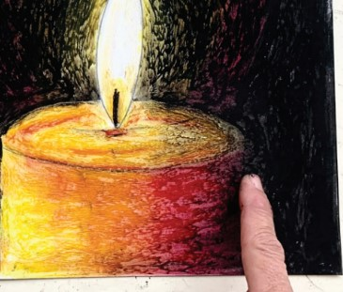
Finishing touches
Use your finger to rub a little black into the dark side of your candle to give it some shadow.

Slide 19
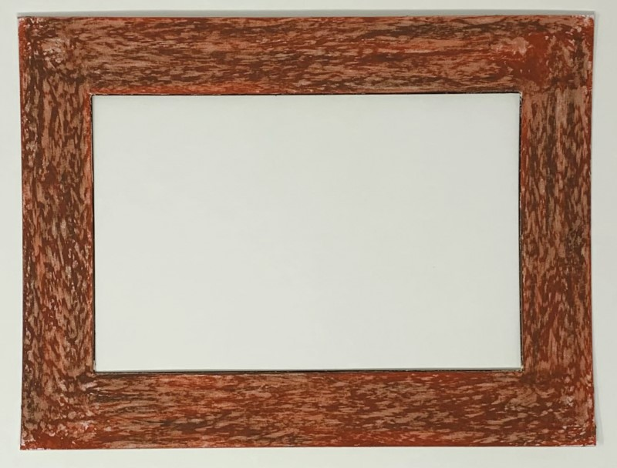
Create your frame
Here, we wanted it to look like wood so after coloring the entire frame with a lighter brown, we added a little dark brown on top and then blended it.

Slide 20
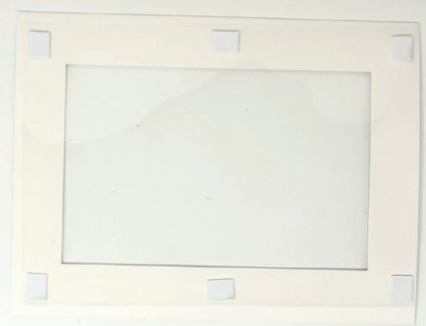
Stick it to the back of the frame pressing firmly.

Slide 21
Assembly
Begin by removing the protective coating from the Mylar and stick 6 foam mounts on the corners and edges as shown here:

Slide 22
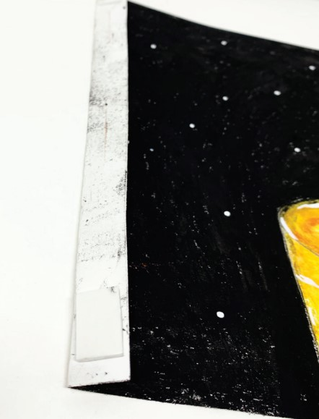
Make a small fold on both sides of your artwork, just big enough for a foam mount to fit. Press a mount to each corner.

Slide 23
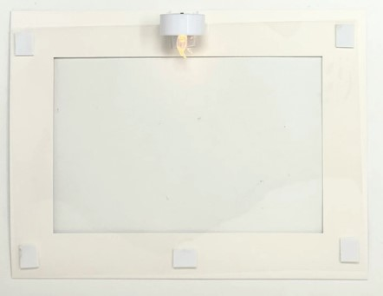
Press a foam mount to your candle and attach the candle to the top of the frame.

Slide 24
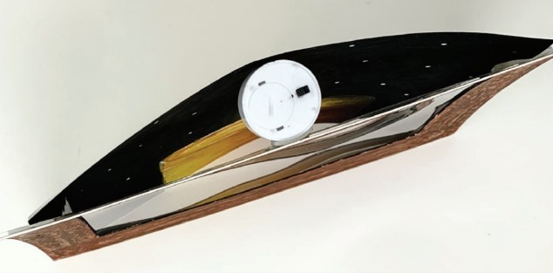
Attach the artwork to the back of the frame and switch on for some oohs and aahs!

